Slide 1
Will You get Heart Disease?
Group member: Mingyang Zhang, Dongying Chen, Ruotong Xu

Slide 2

Research Topic
How can we predict heart disease?
“
“
Heart disease is the number one killer of human health. The death toll of 1/3 people worldwide is caused by heart disease, and in China, hundreds of thousands of people die of heart disease every year. Therefore, if we can extract the body-related indicators, and analyze the influence of different characteristics on heart disease through data mining, it will play a vital role in predicting and preventing heart disease.
Motivation
Research

Slide 3
Agenda
01
Data Exploration
02
Hypotheses
03
Methodologies and Results
04
Conclusion

Slide 4
Data Exploration

Slide 5
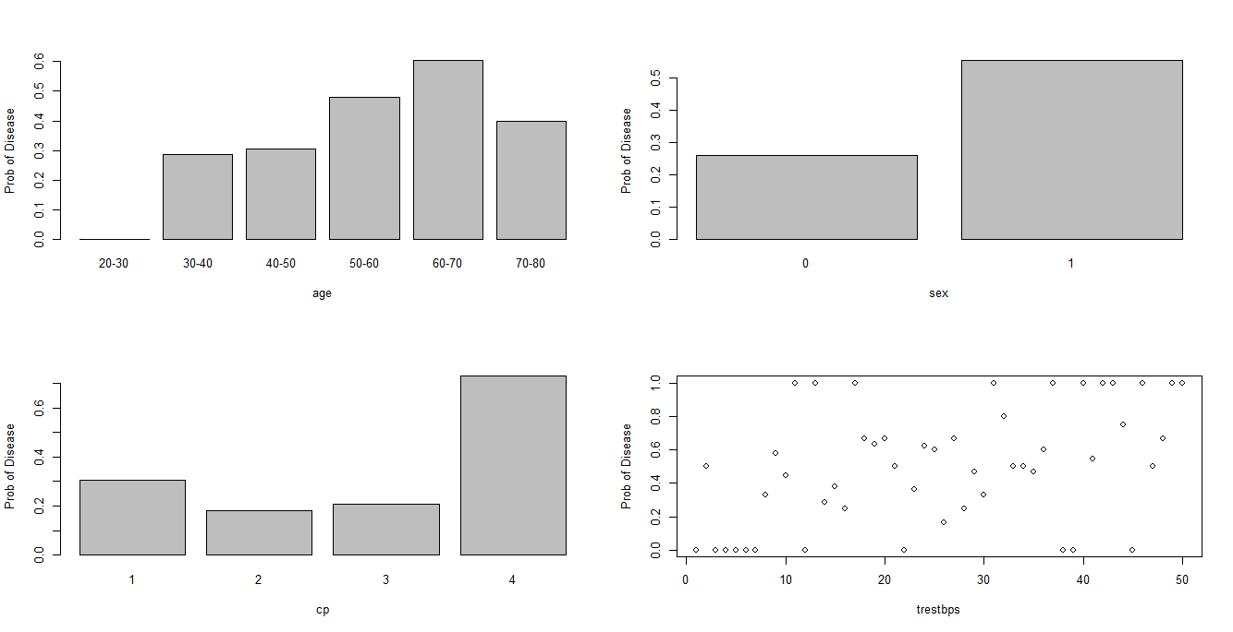
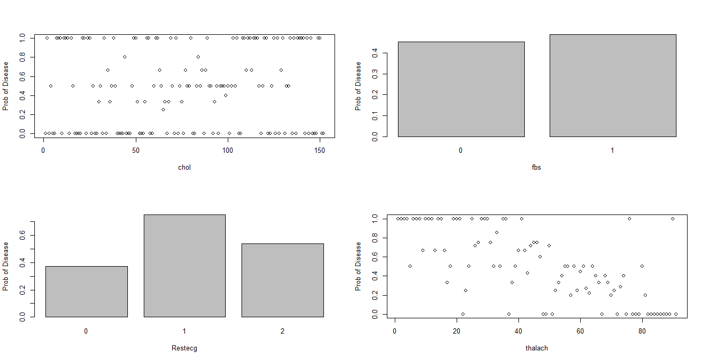
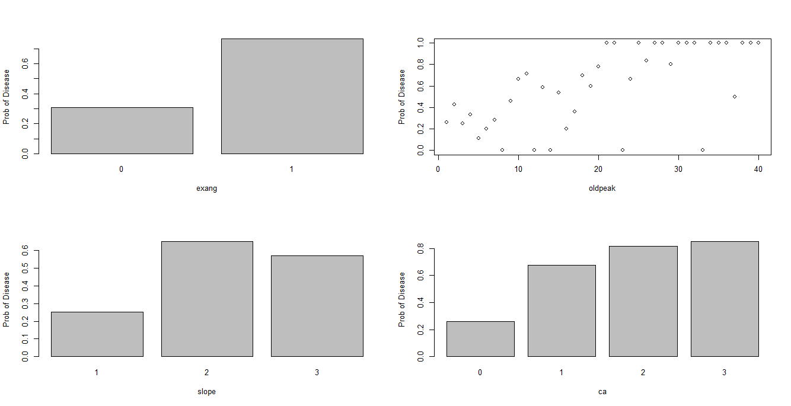
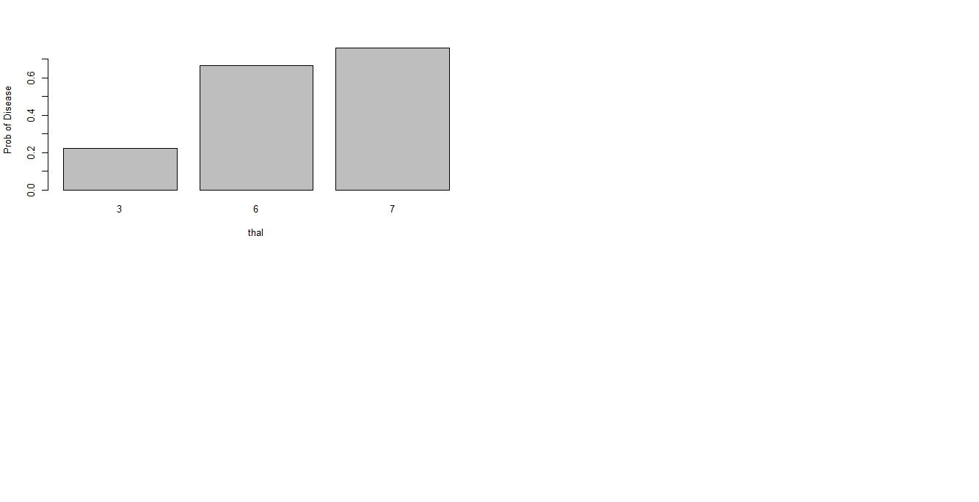
Exploration
Results
Age
Sex
cp
fbs
Restecg
thalach
exang
oldpeak
slope
ca
thal

Slide 6
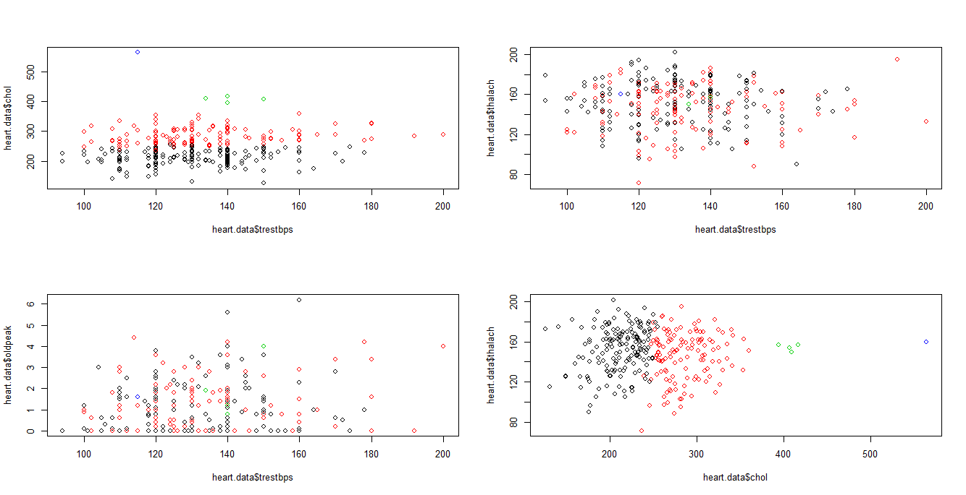
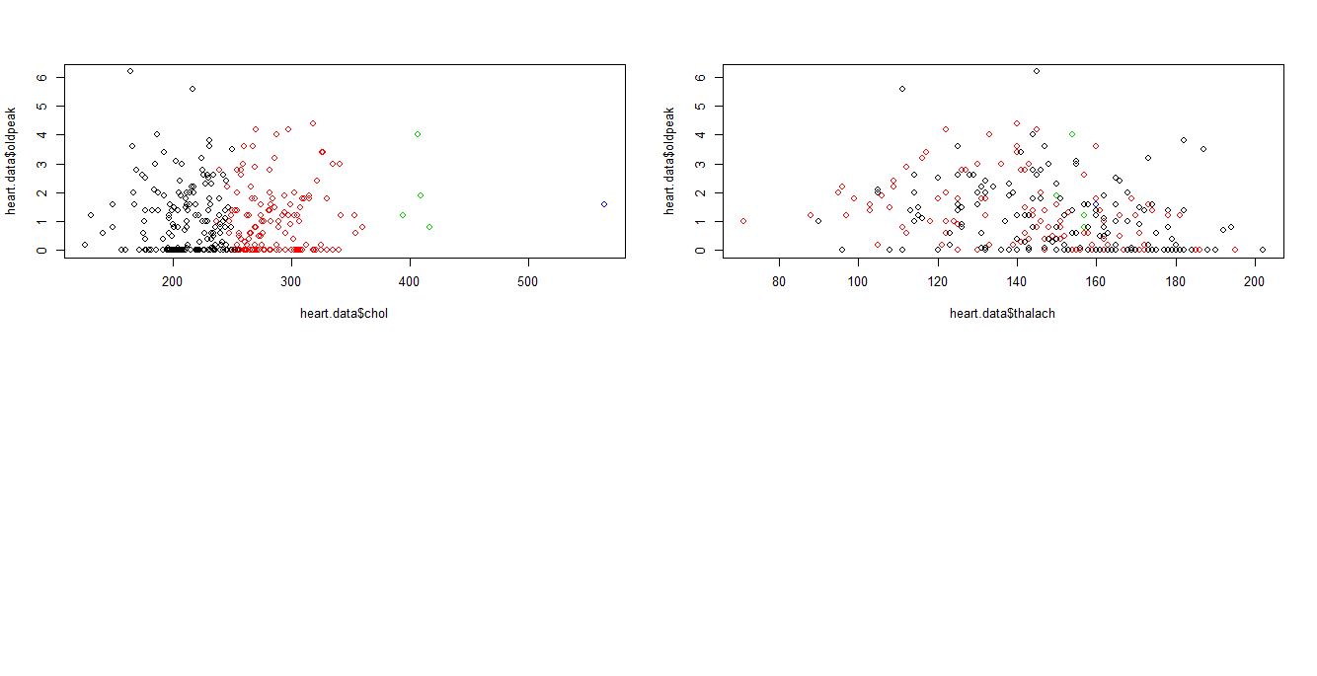
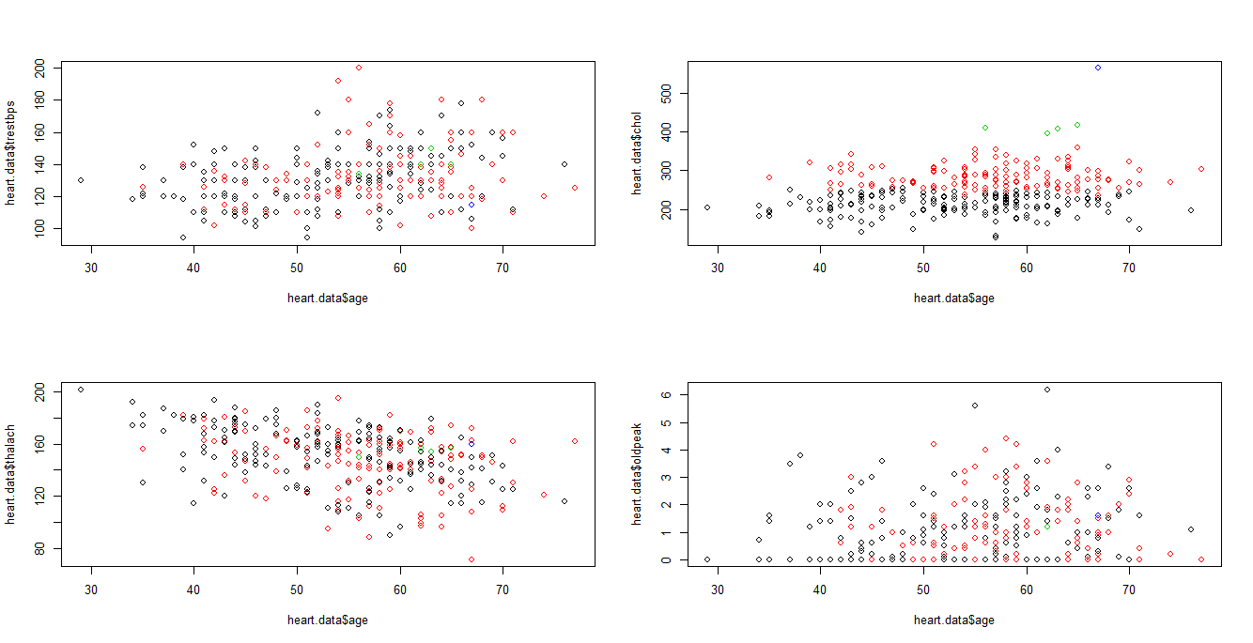
Hierarchical Clustering
No obvious relationships

Slide 7
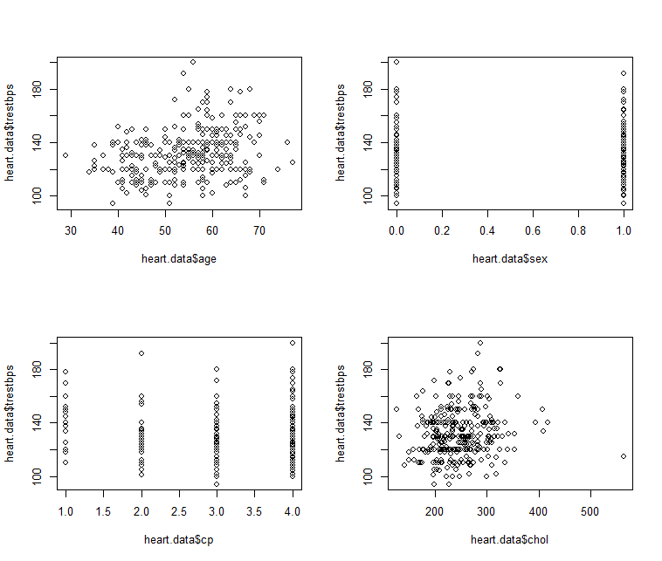
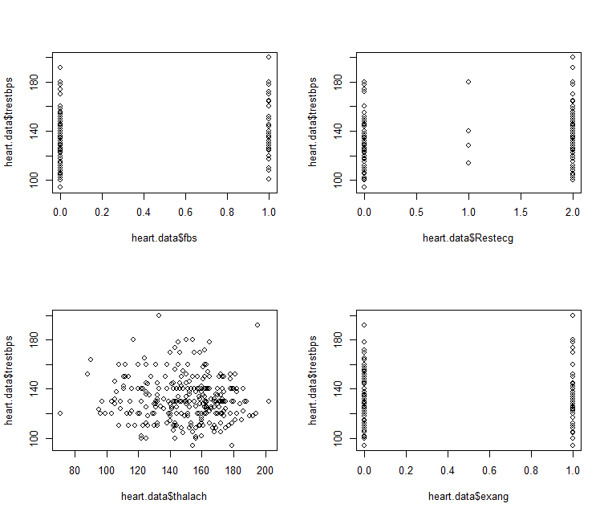
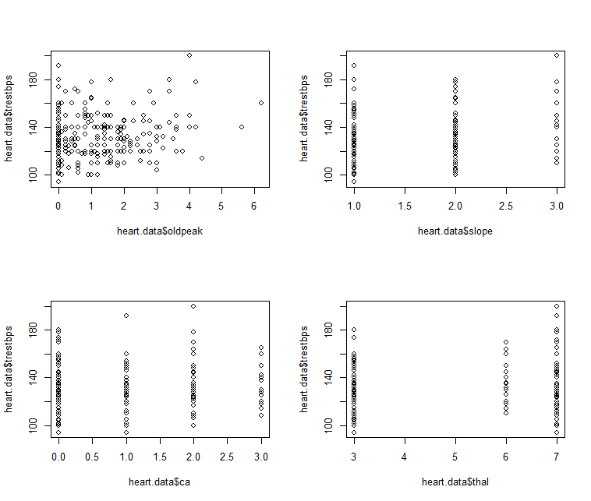
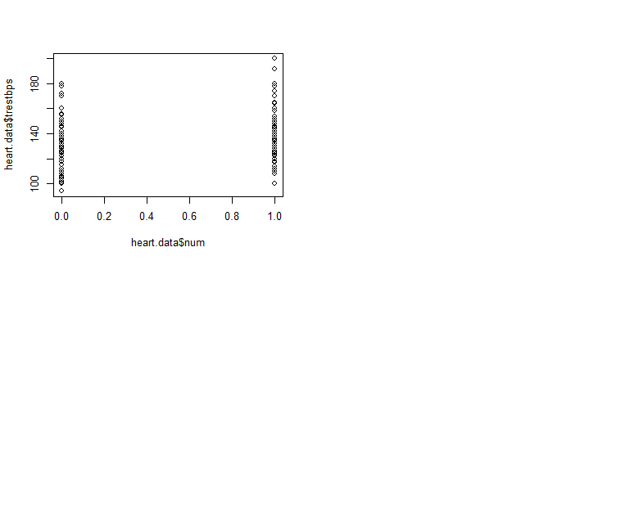
Trestbps and other variables
Age
Chol
Thalach
Oldpeak

Slide 8
Hypotheses

Slide 9
Age ~ num
01
04
Trestbps ~ num
60-70 years old people are most likely to have heart disease.
02
Sex ~ num
05
Oldpeak ~num
men have higher possibility to get heart disease than women
Cp ~ num
03
06
Trestbps ~ other predictors
Asymptomatic chest pain(Cp4) is closely related to heart disease

Slide 10
Methodologies & Results

Slide 11
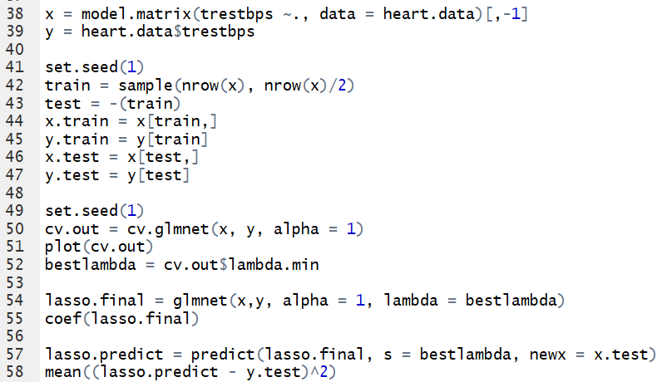
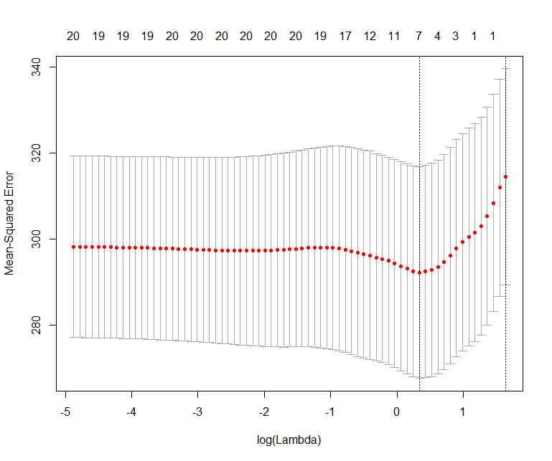
Multiple Linear Regression
Estimation method: LASSO + Cross Validation
Trestbps (resting blood pressure) with other variables

Slide 12
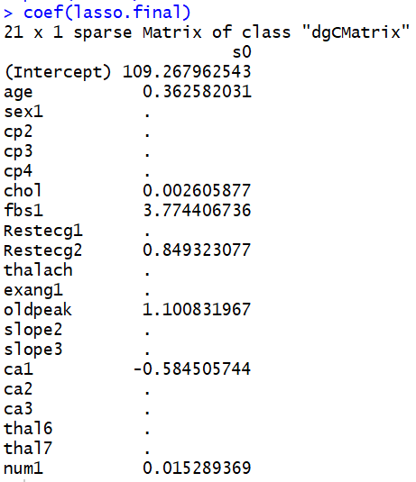
Multiple Linear Regression
Estimation method: LASSO + Cross Validation
Trestbps (resting blood pressure) with other variables
Age – Positive
Chol: serum cholesterol in mg/dl - Positive
Fbs1: fasting blood sugar > 120 – Positive
Restecg1: resting electrocardiographic results
(showing probable or definite left ventricular hypertrophy by Estes' criteria) – Positive
Ca1: number of major vessels (0-3) colored by flouroscopy - Negative
Num1

Slide 13
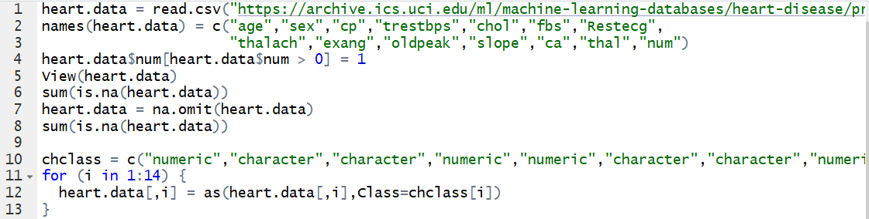
Logistic Regression 1
Estimation method: maximum likelihood method
Step 1

Slide 14
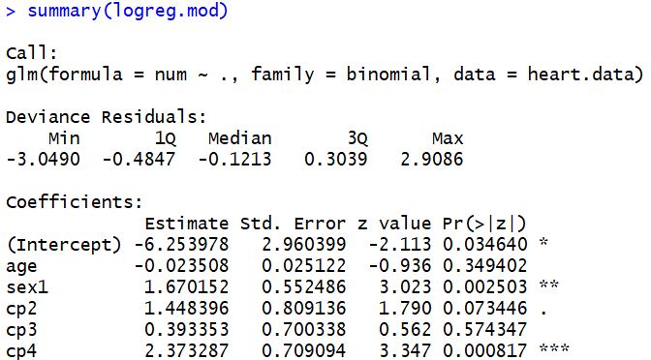
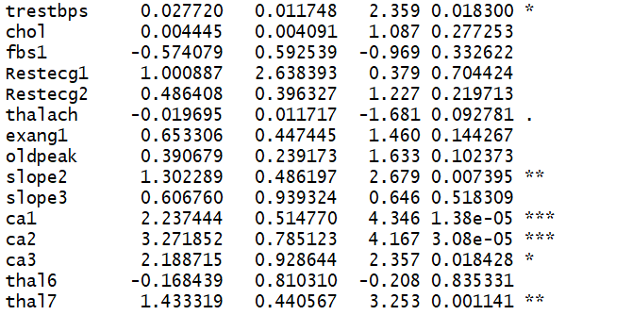
Logistic Regression 1
Estimation method: maximum likelihood method
Step 2

Slide 15
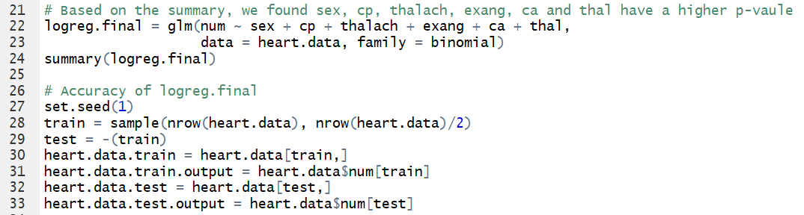
Logistic Regression 1
Estimation method: maximum likelihood method
Step 3

Slide 16
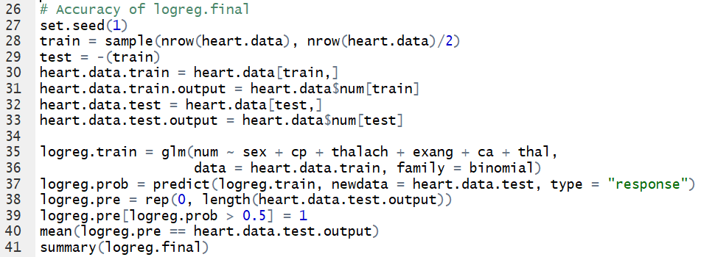
Logistic Regression 1
Estimation method: maximum likelihood method
Step 4

Slide 17
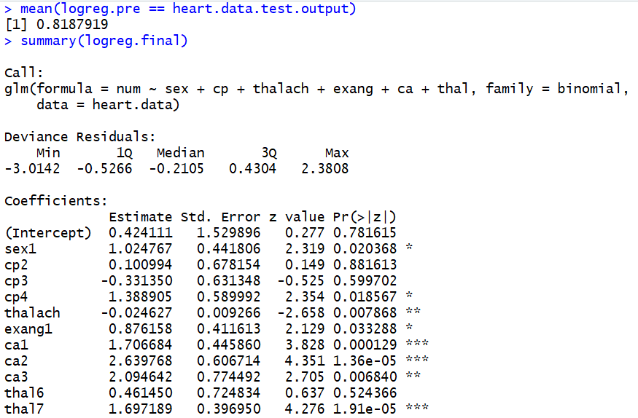
Logistic Regression 1
Estimation method: maximum likelihood method
Results
Still have weakness

Slide 18
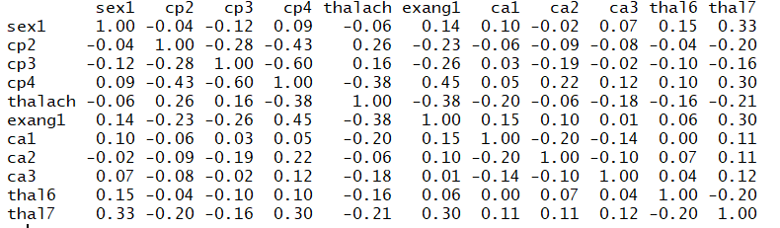
Check Logistic Regression Assumption
Multicollinearity (relationship between independent variables)
Correlation Matrix
We could use LASSO to delete some variables that have relationship

Slide 19
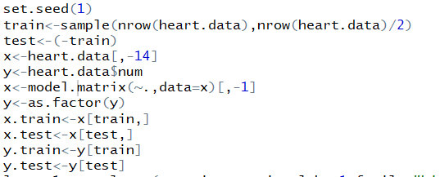
Logistic Regression 2
Estimation method: LASSO + Cross Validation
Step 1 Same as maximum likelihood method, data processing
Step 2

Slide 20
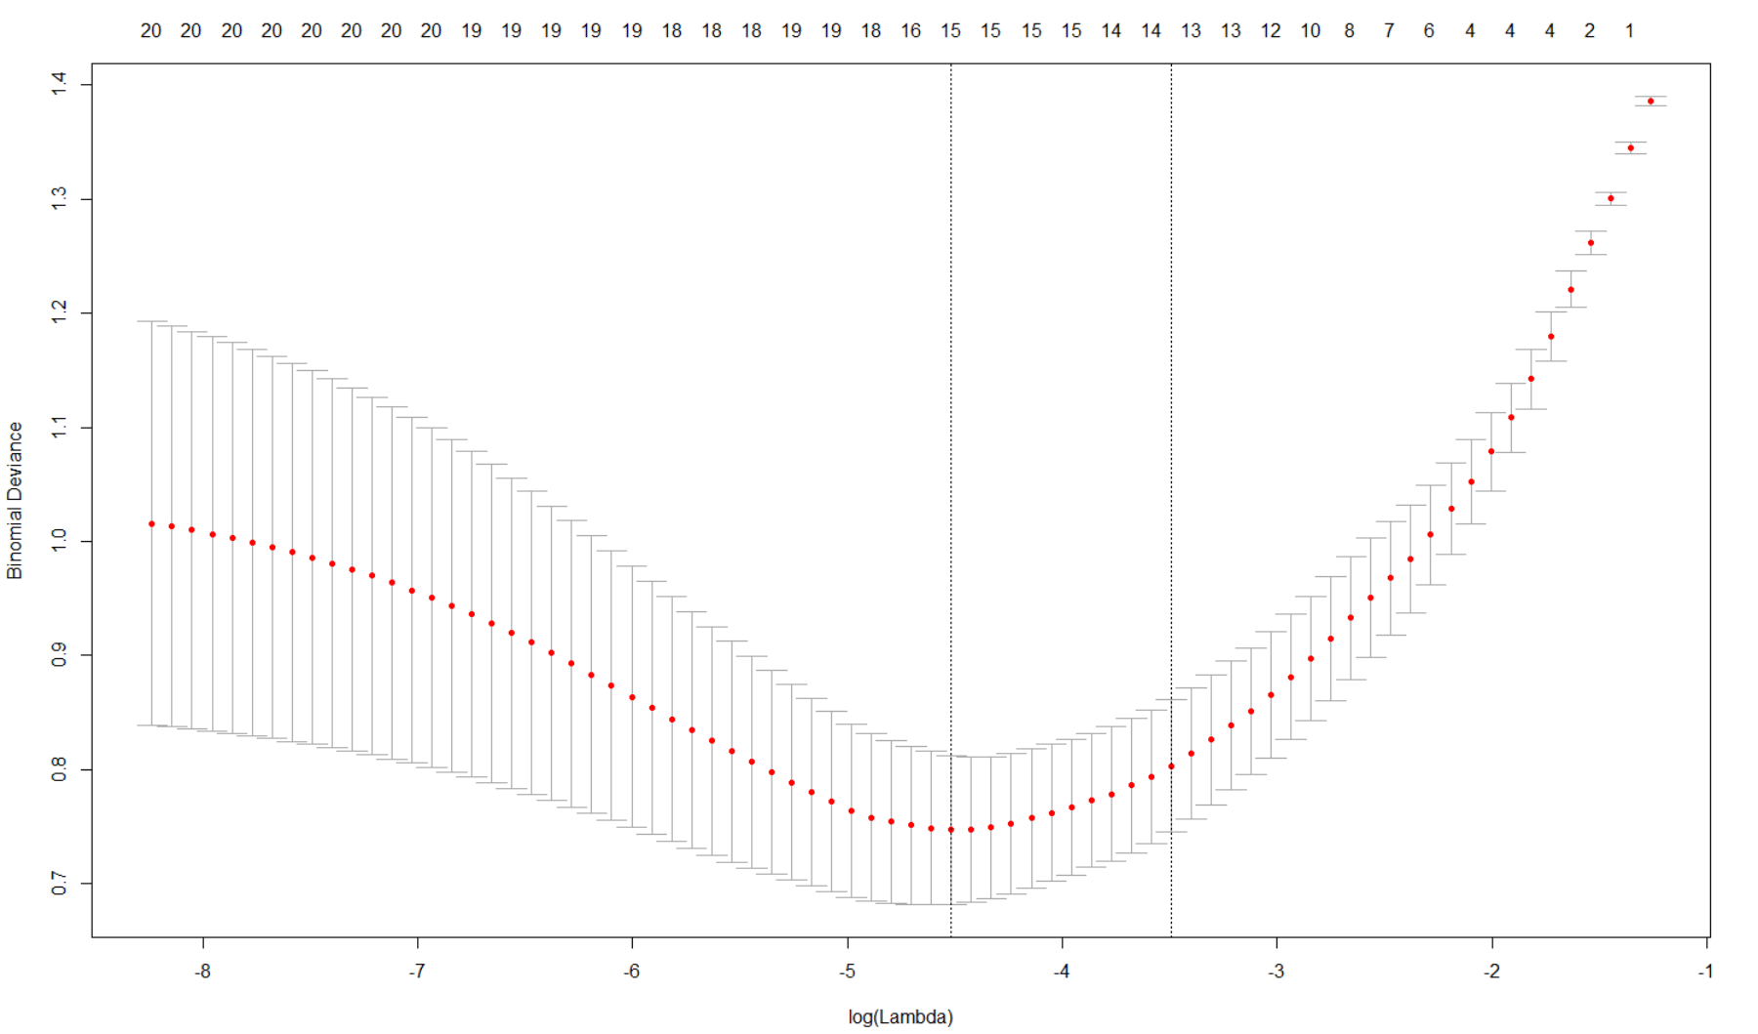
Logistic Regression 2
Estimation method: LASSO + Cross Validation
Step 3

Slide 21
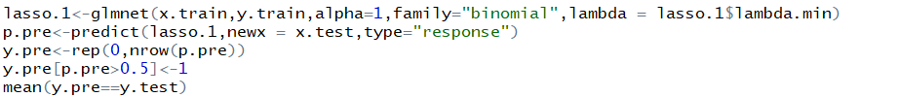
Logistic Regression 2
Estimation method: LASSO + Cross Validation
Step 4

Slide 22
Logistic Regression 2
Estimation method: LASSO + Cross Validation
Step 4

Slide 23
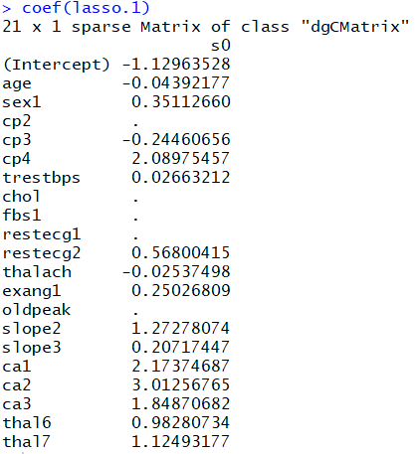

Logistic Regression 2
Estimation method: LASSO + Cross Validation

Slide 24
Conclusion
What are some takeaways from our results?

Slide 25
Conclusion
Through the model provided above, more than 80% of heart disease prediction accuracy can be achieved. The model can be used to make predictions and assist doctors in preventing and treating heart disease.

Slide 26
Thank you
Any Questions?

